Slide 1
Arduino Workshop
By students at TI-CEPD, NSUT under Prof. Dhananjay V. Gadre

Slide 2
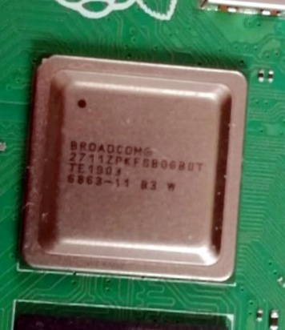
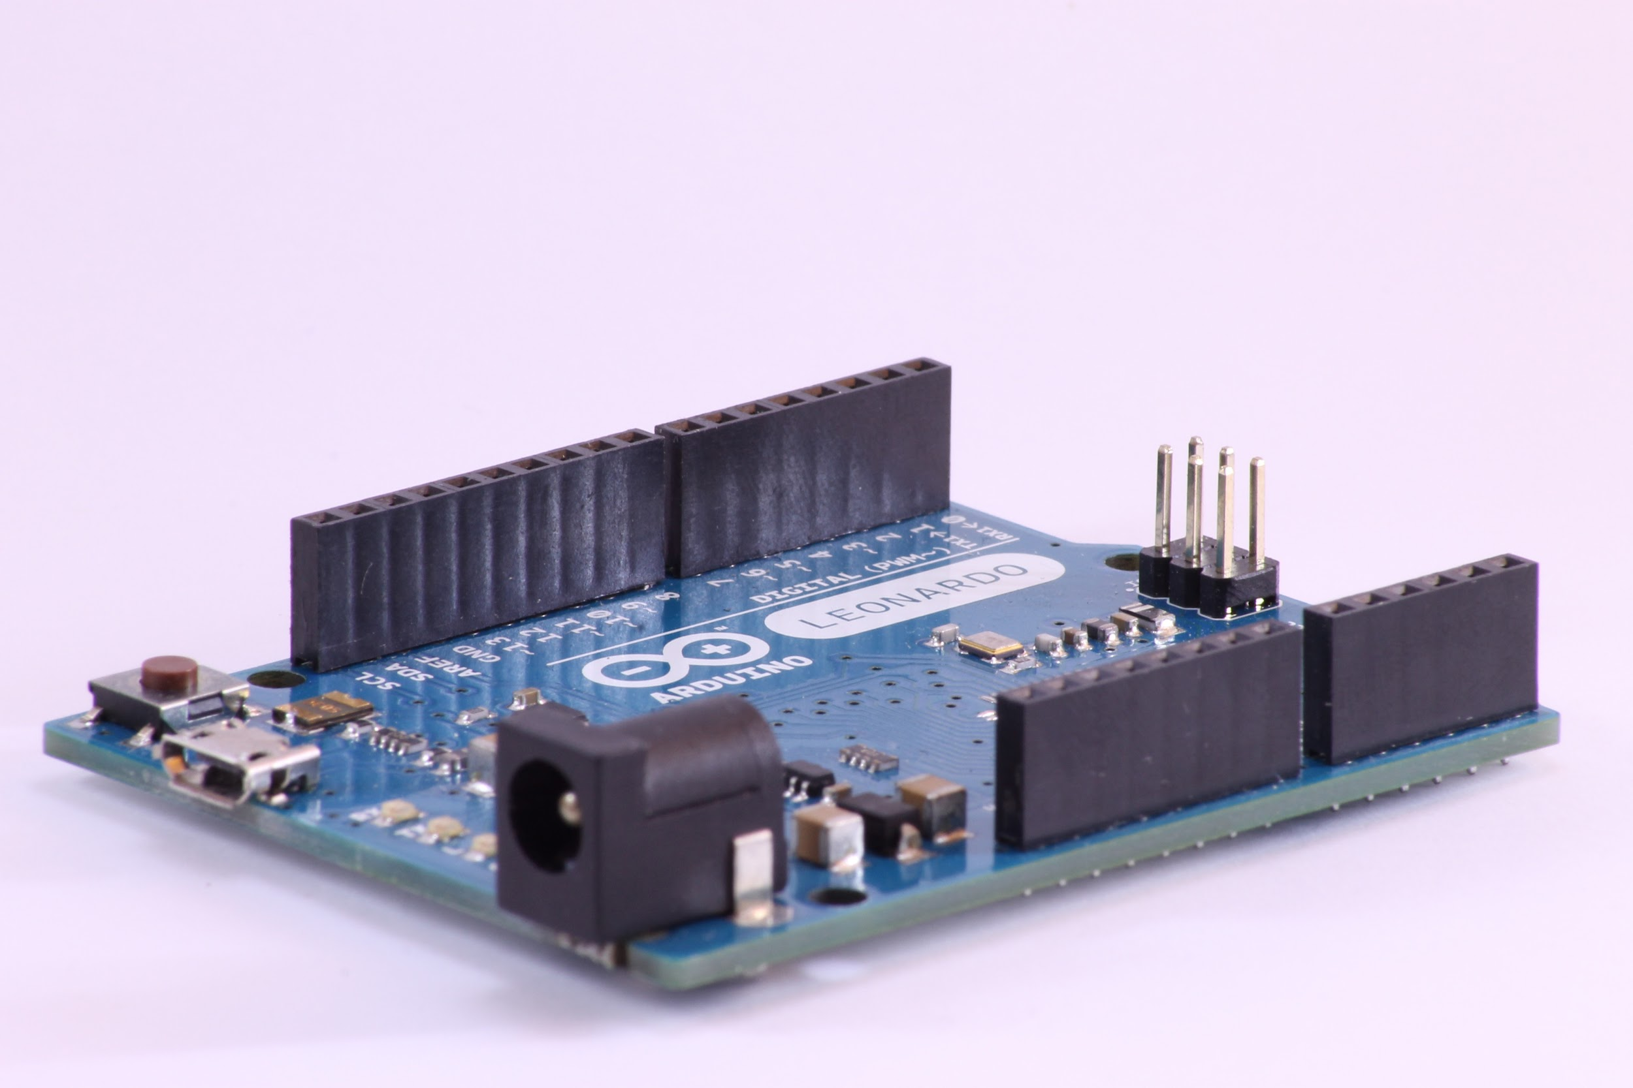
Microprocessor vs Microcontroller
Notes:
Microprocessor is a powerful CPU on a single chip that connects to external peripherals
Microcontroller puts the CPU and peripherals all on a single chip

Slide 3
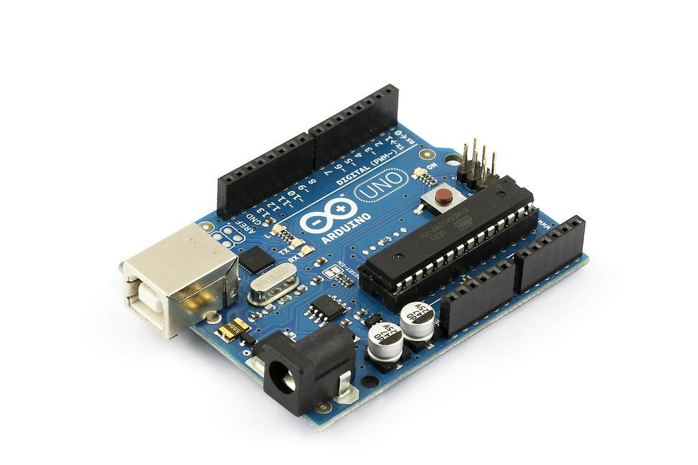
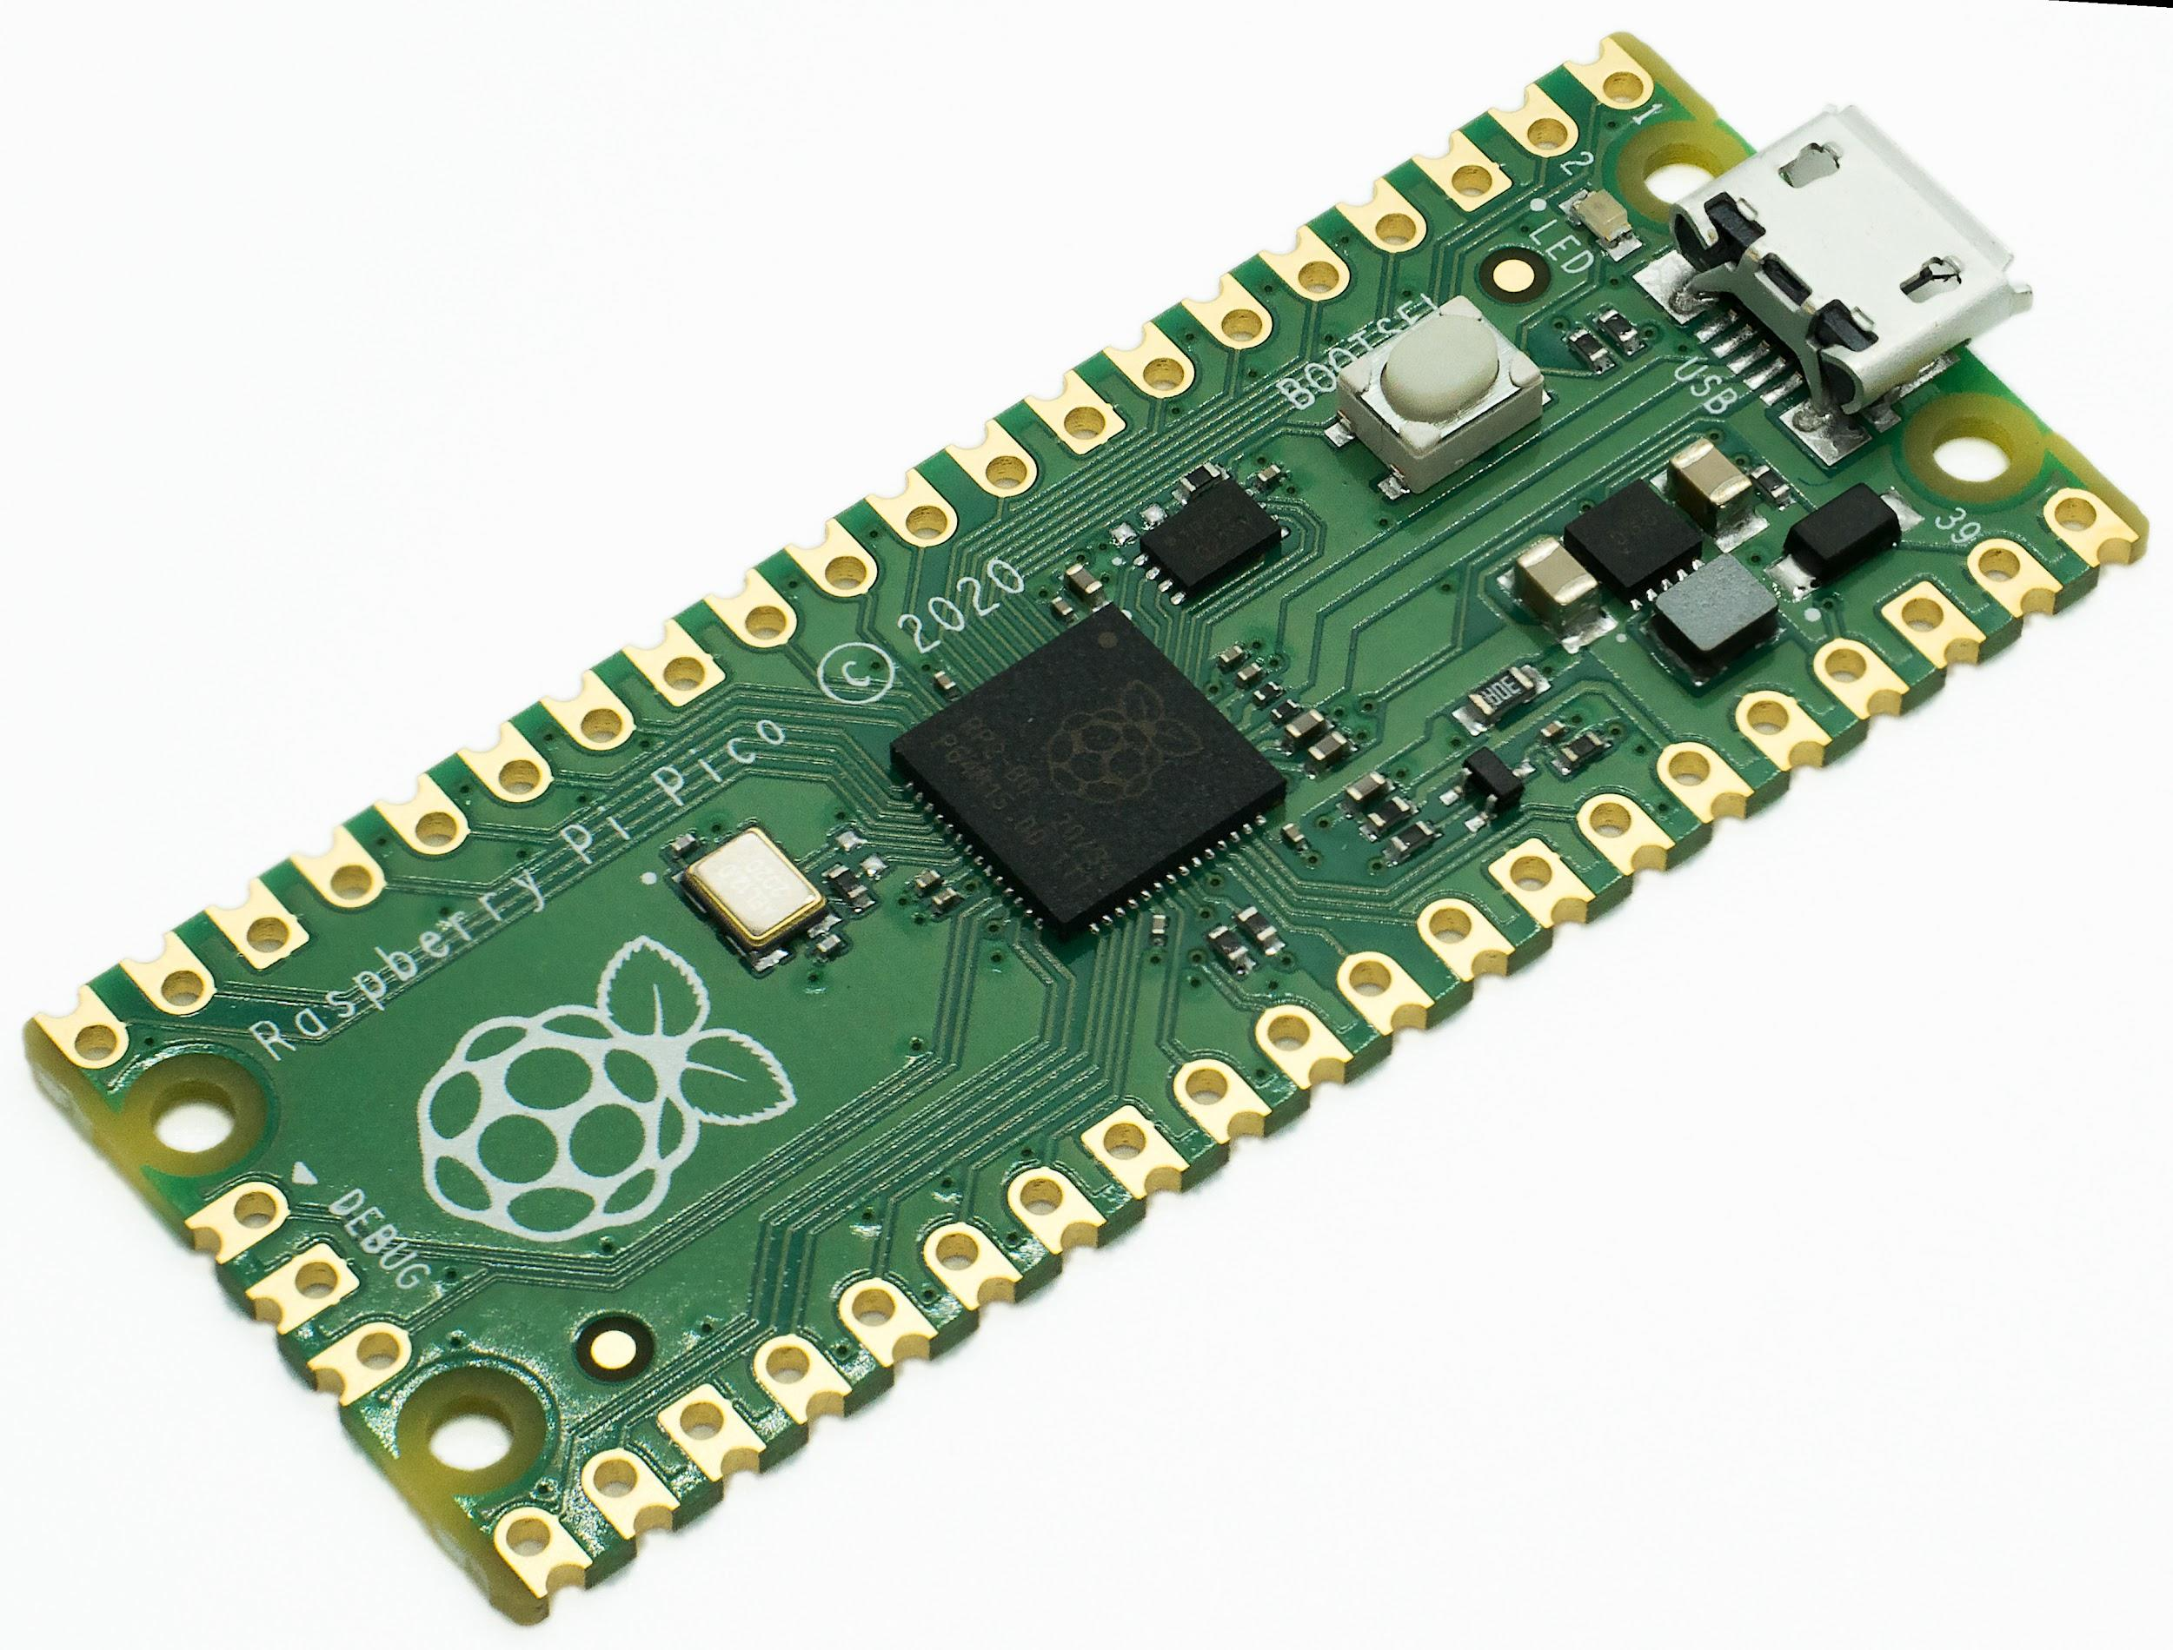
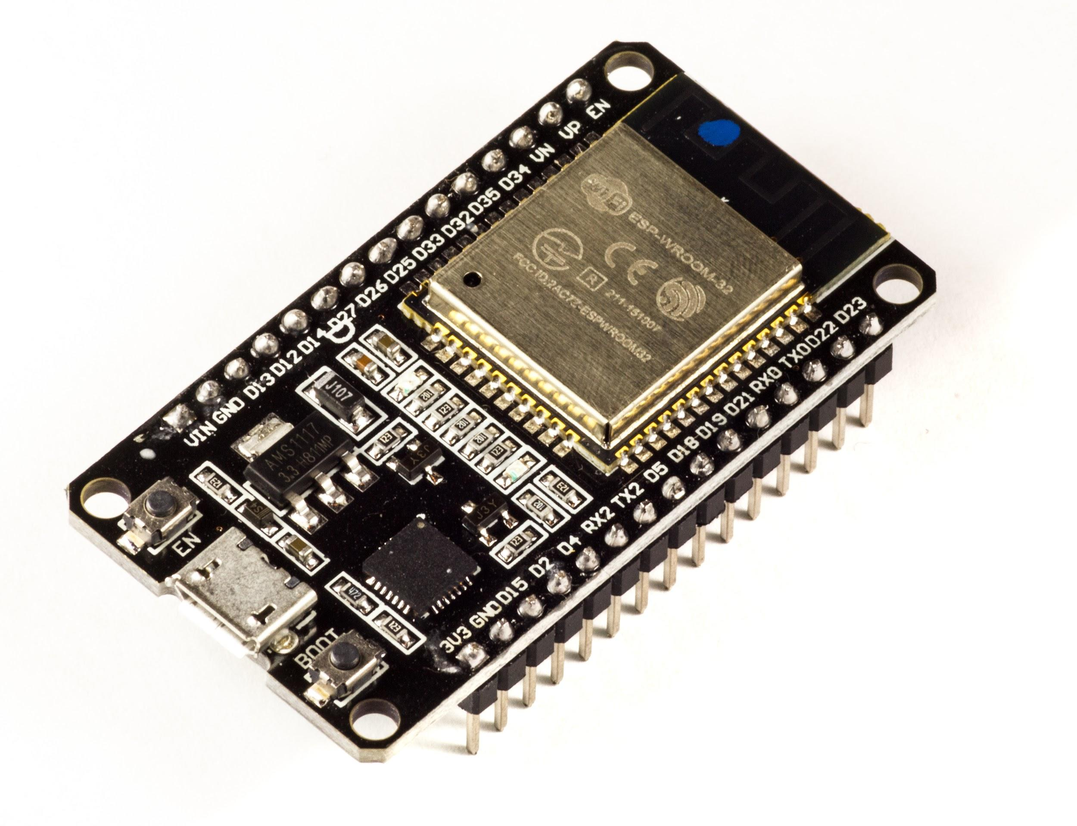
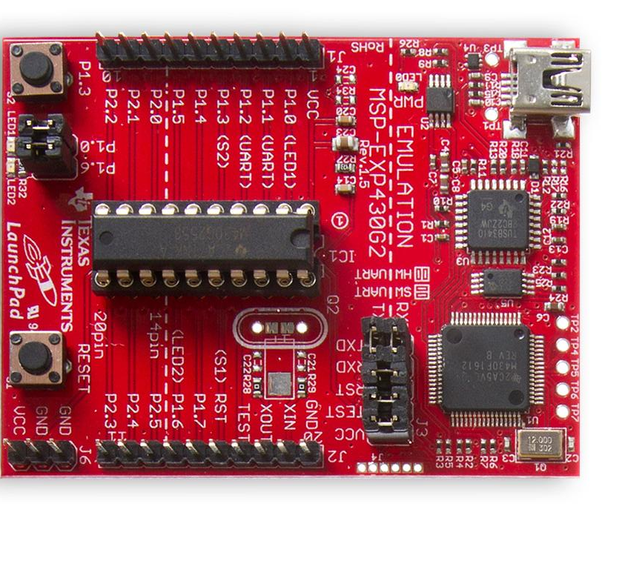
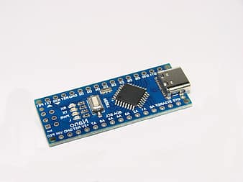
Arduino, the most famous MC
Notes:
Arduino is an Italian company,
Main products are Arduino board, like Arduino Uno and Nano
These are basically the same board, one is just a shrunken down version of the other
Over 10 million sales of these boards
Many other microcontrollers exist, but we chose Arduino because its most popular

Slide 4
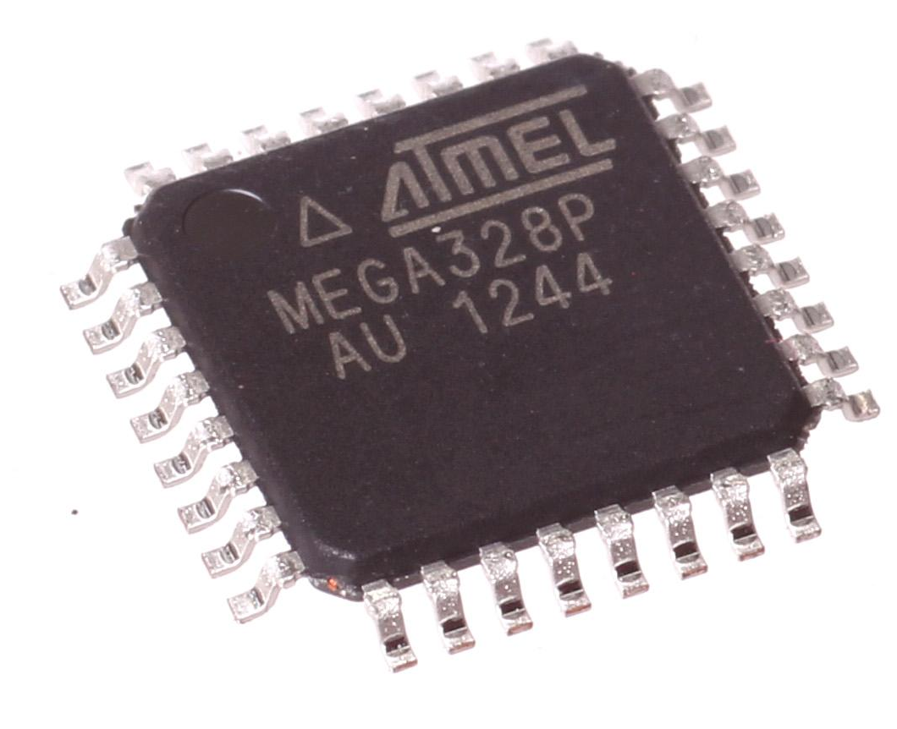
Arduino’s microprocessor
Notes:
Brains of Arduino, if you want to learn to program any microprocessor from scratch, google it and look at its datasheet

Slide 5

Arduino IDE
People at Arduino studied the datasheet for Atmel MEGA328P and reduced and simplified its operations for use in the Arduino IDE
Notes:
After this open Arduino IDE and explain interface,
Upload button, verify button, choose board, choose port (unplug and plug arduino to find port), error window,
Then have them open examples section and upload blink

Slide 6
setup and loop
SETUP
LOOP
Is only run once in an Arduino program and is used to initialize variables, set pins as input or output etc
Runs continuously non-stop until the program is terminated
Notes:
Talk about pinMode, digitalWrite, delay (show arduino reference for delay) and upload example

Slide 7
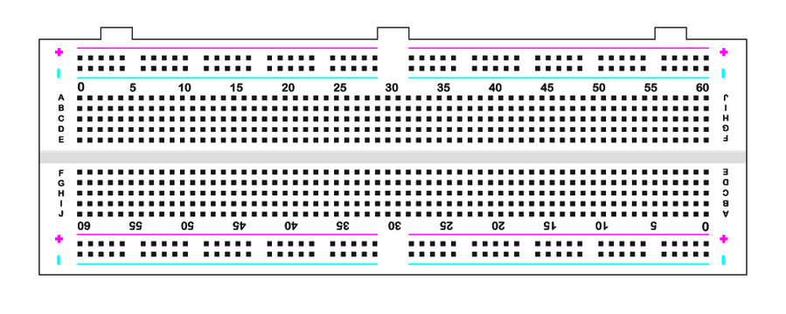
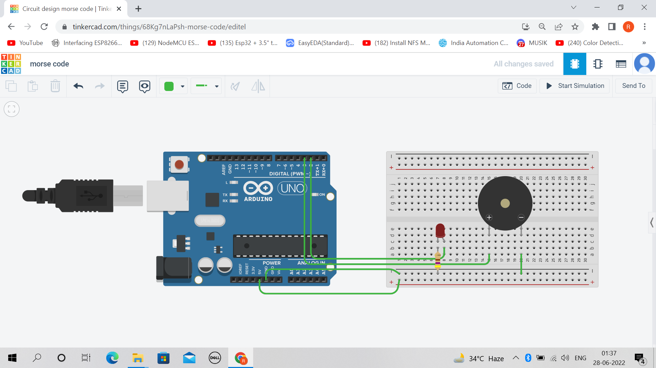
Solderless Breadboards
Notes:
Middle pins are connected vertically, 5 in a row
There are horizontal rails which are generally used for +5v and 0v
Use case of breadboard, as you can see, we dont have to pinch and twist any wire for connection, LED is simply put into adjacent holes and wires connected

Slide 8
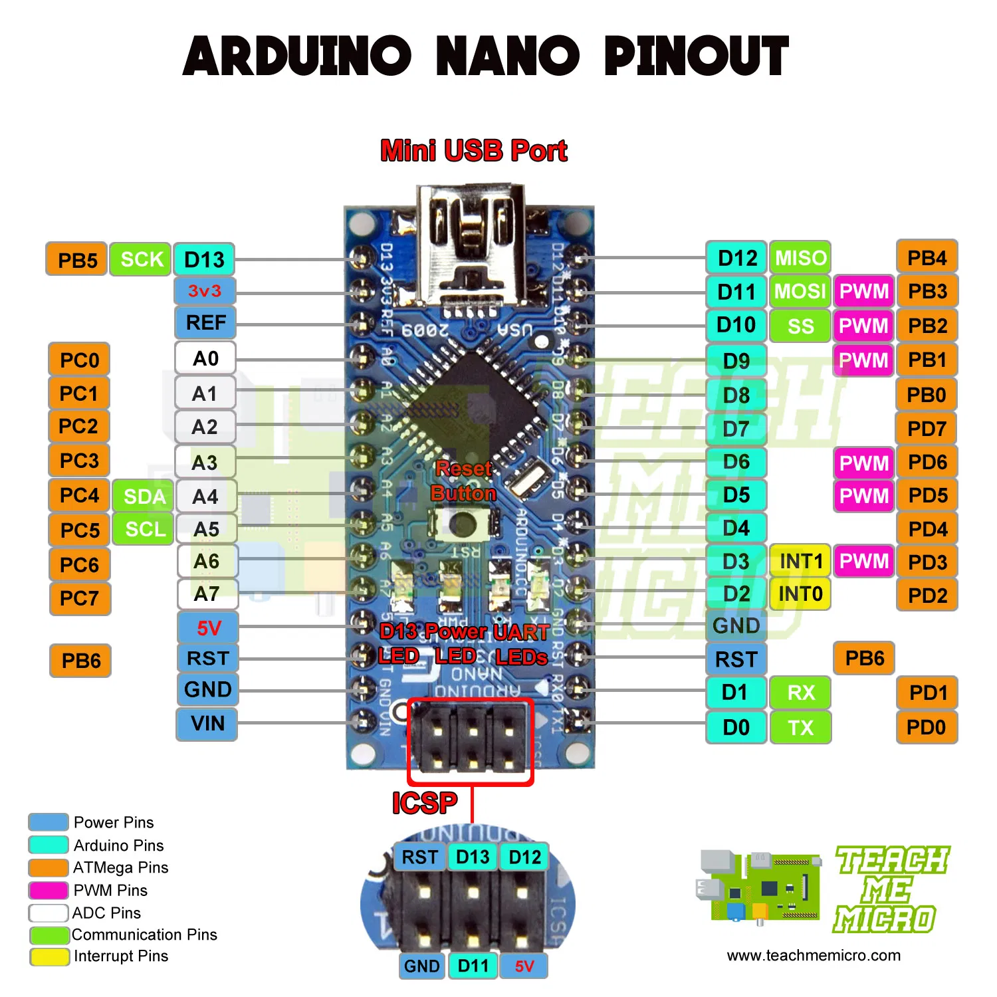

Slide 9
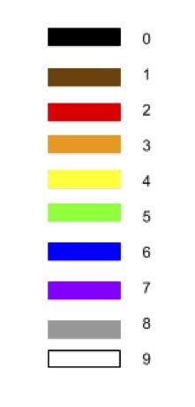
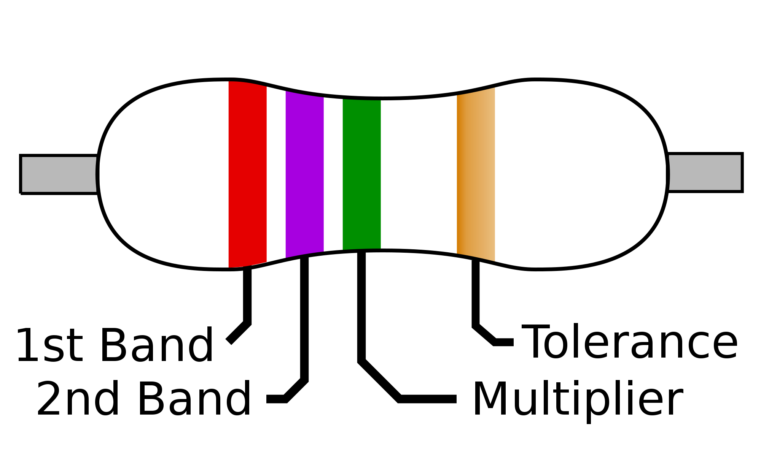
First Circuit!!!
Change the LED_BUILTIN used in the program to any other I/O pin you see on the Arduino Nano
Use any of the 3 color LEDs in your kits and attach the positive end of that LED to the pin you selected in the program and negative end to GND (same as 0V)
But we need a Resistor in series with the LED to limit the current through it!!
Notes:
Find series resistance for Red, Green and Blue LED on whiteboard

Slide 10
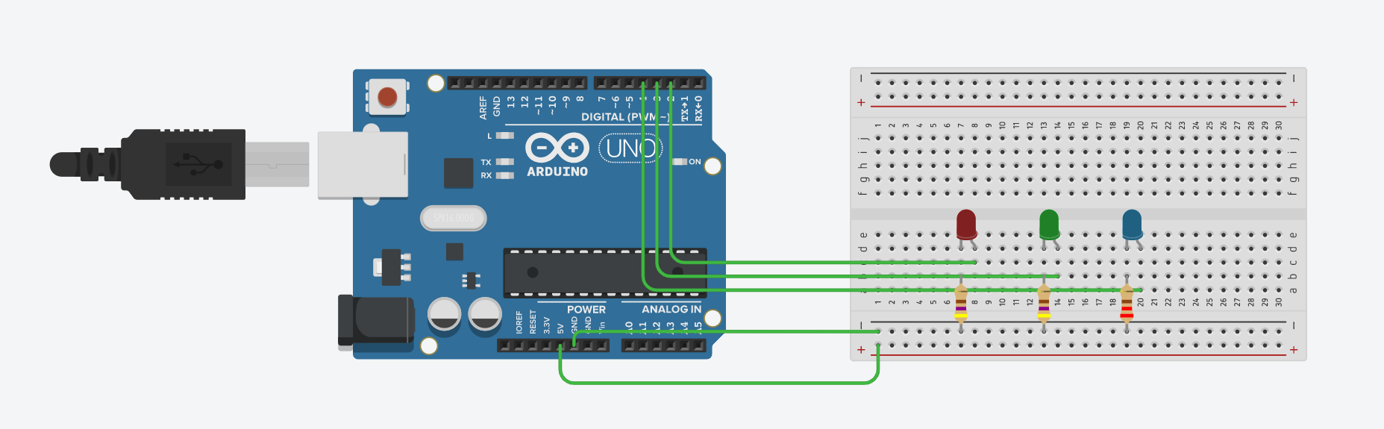

Slide 11
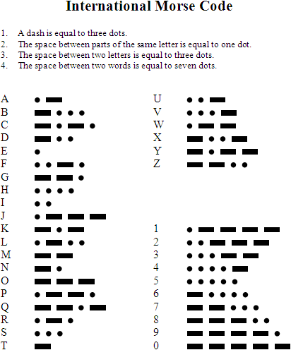
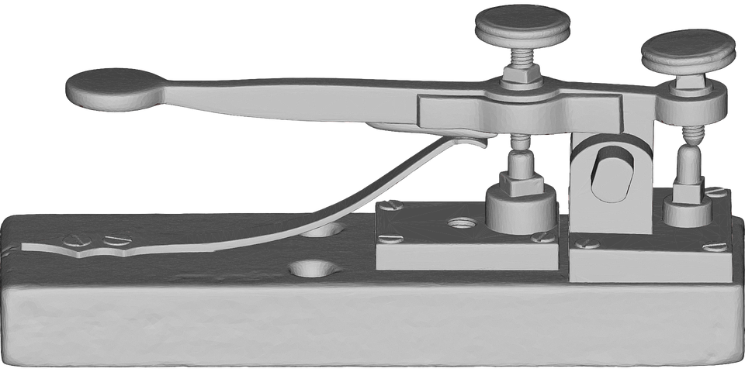
New Project - Morse Code!!
Notes:
Open new project and start writing

Slide 12
“Hello”
Notes:
Write the program for text to morse

Slide 13
What if we want to take an input?
For taking input we use the digitalRead() function, this function just checks if the voltage at the pin specified is HIGH (5v) or LOW (0v) and we can use the result in our programs
But a button can only make or break a circuit, how do we provide HIGH and LOW logic to pins?

Slide 14
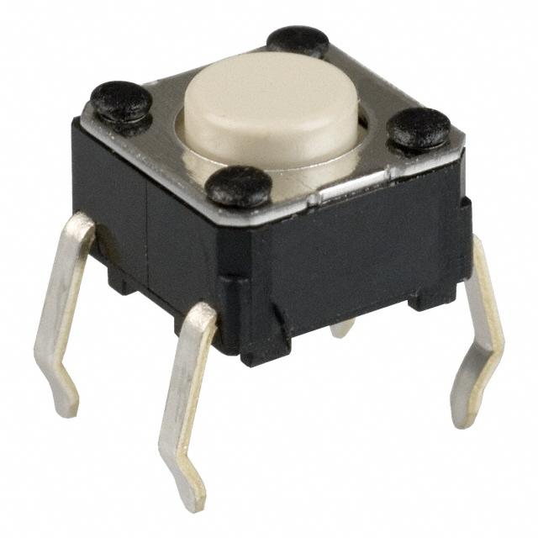
digitalWrite() and digitalRead()
Omron Switch

Slide 15
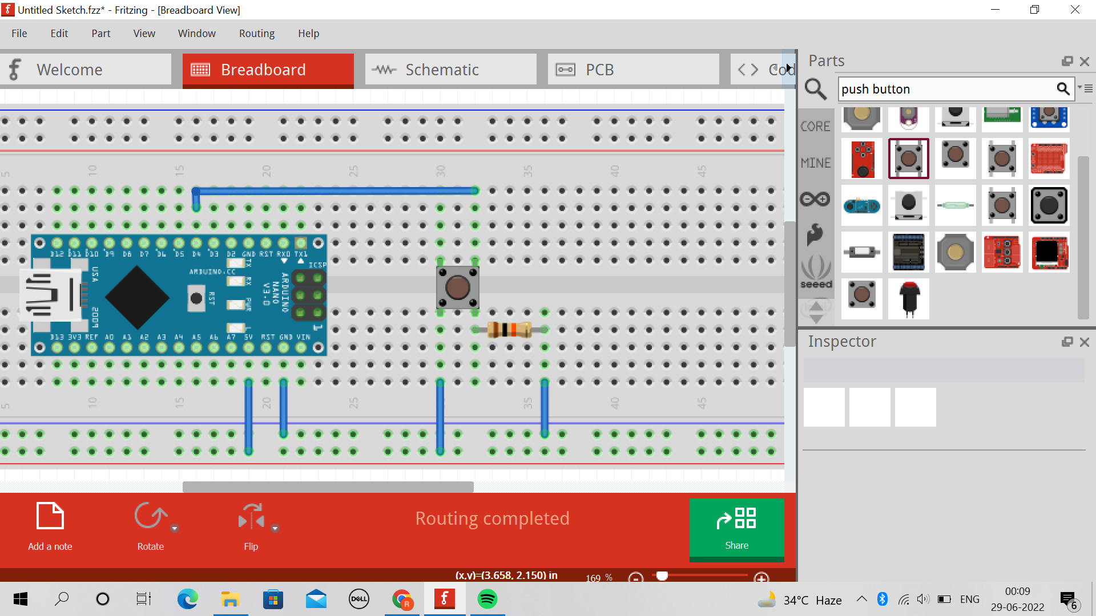

Normally pulled LOW
Normally pulled HIGH
Notes:
Explain button pull up and pull high configurations

Slide 16
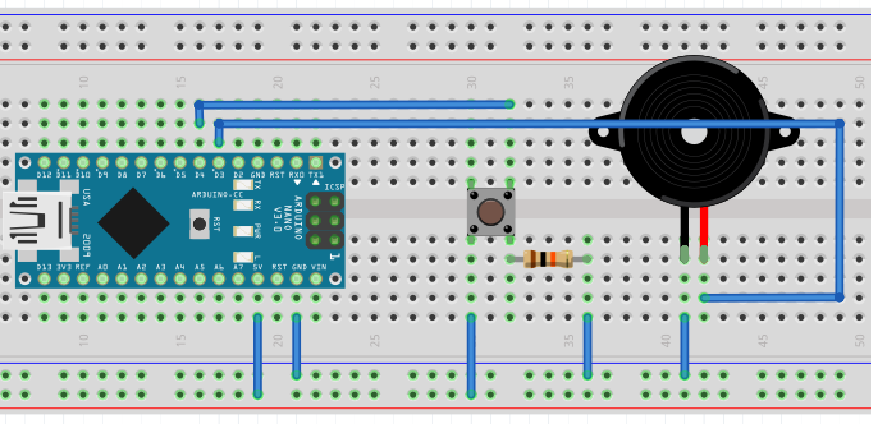
digitalRead()!!
Objective: Press button to make noise

Slide 17
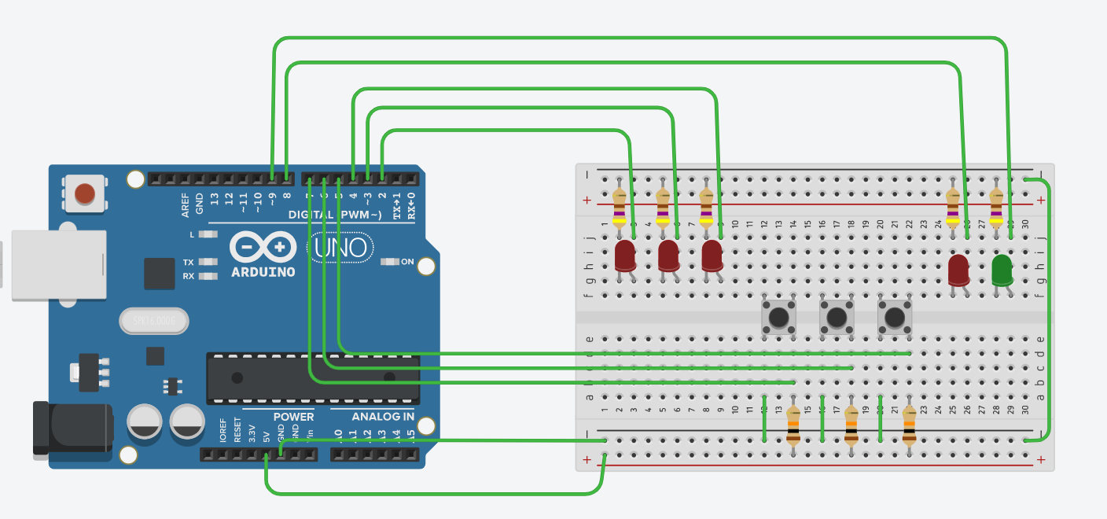
LED Memory Game!!!

Slide 18
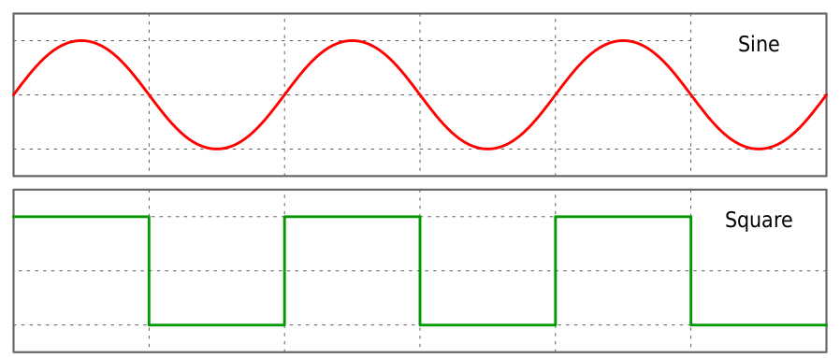
Working with Analog signals
We need an ADC (Analog to Digital Converter)

Slide 19
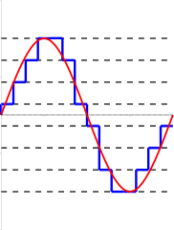
Arduino ADC
Arduino has a 10 bit ADC
Which means the number of levels an analog signal is divided
Into in 2^10 = 1024 levels
Thus reading an analog voltage gives us a number in the range of 0 to 1024

Slide 20
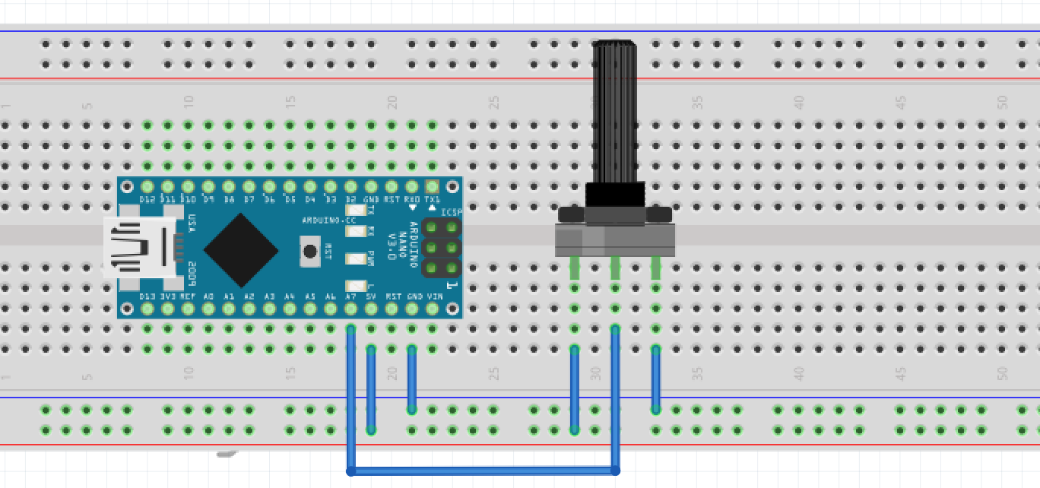
ADC Test
We will use Serial to see the value of analogRead()

Slide 21
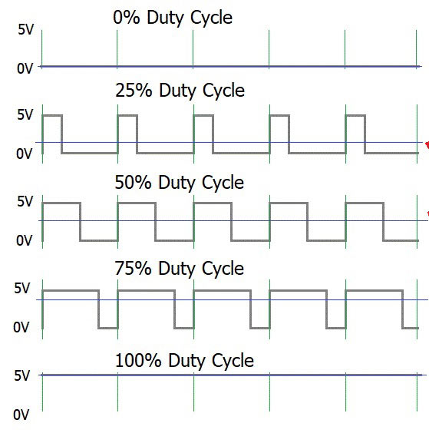
analogWrite() with PWM
PWM -> Pulse Width Modulation
analogWrite() does not work the same way
as analogRead()

Slide 22
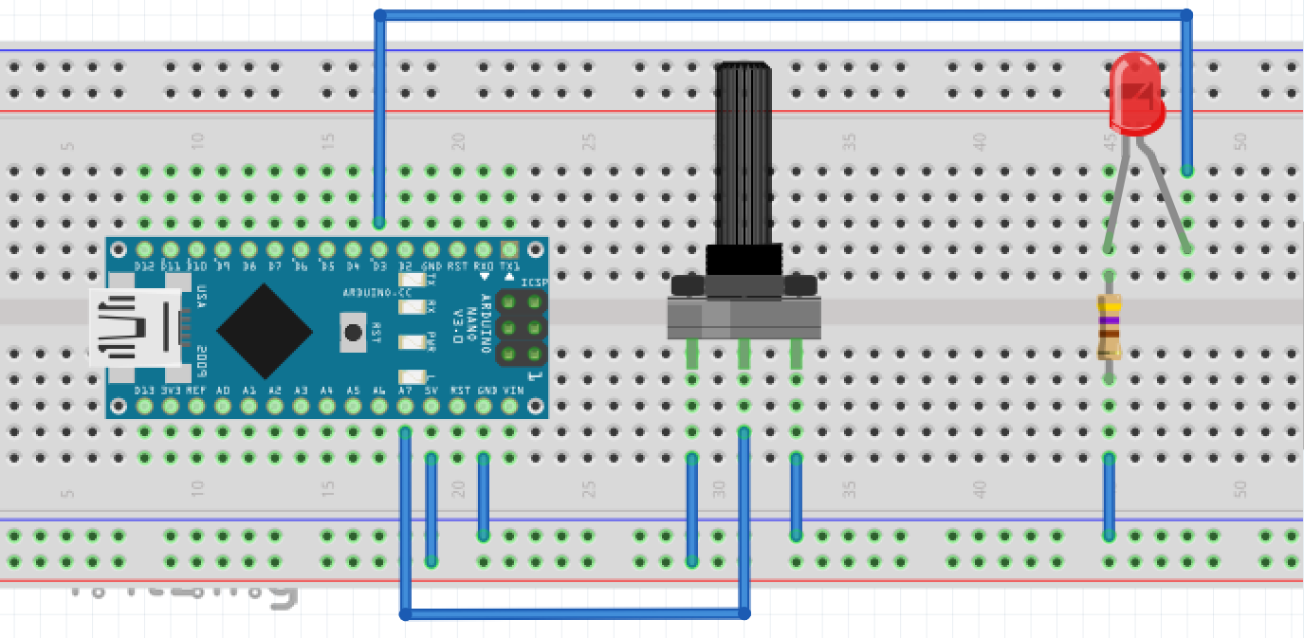
Using our analogRead() value from Potentiometer!!

Slide 23
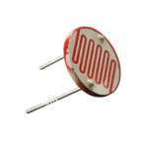
Light to Sound
We will make something similar to the light probe for visually impaired students
For that we need an LDR (Light Dependant Resistor)
LDR is a variable resistor whose value varies as per the amount of light falling on it
So we need to convert this variable resistance to something we can read using analogRead()
Notes:
Explain the resistor divider circuit

Slide 24
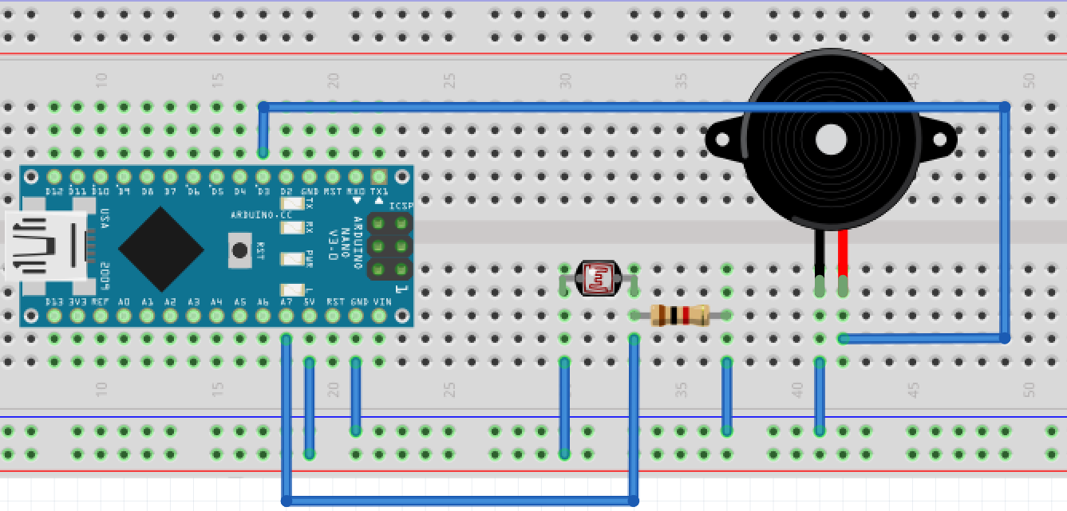

Slide 25
Thank You!!!
There is a lot we couldn't cover…
We have only scratched the surface in terms of what one can do with an arduino, there is so much more to explore and test.
For eg. we can control LCD displays with arduino + Speakers with arduino, we can use 1000s of different kinds of sensors for monitoring experiments, taking observations, etc.
Refer to arduino.cc or any just google “How to do ______ on arduino”
Also feel free to reach out to us on Whatsapp or our Linkedin
Mudit Aggarwal, Rohan Deswal and Reshul Jindal at NSUT

